Slide 1
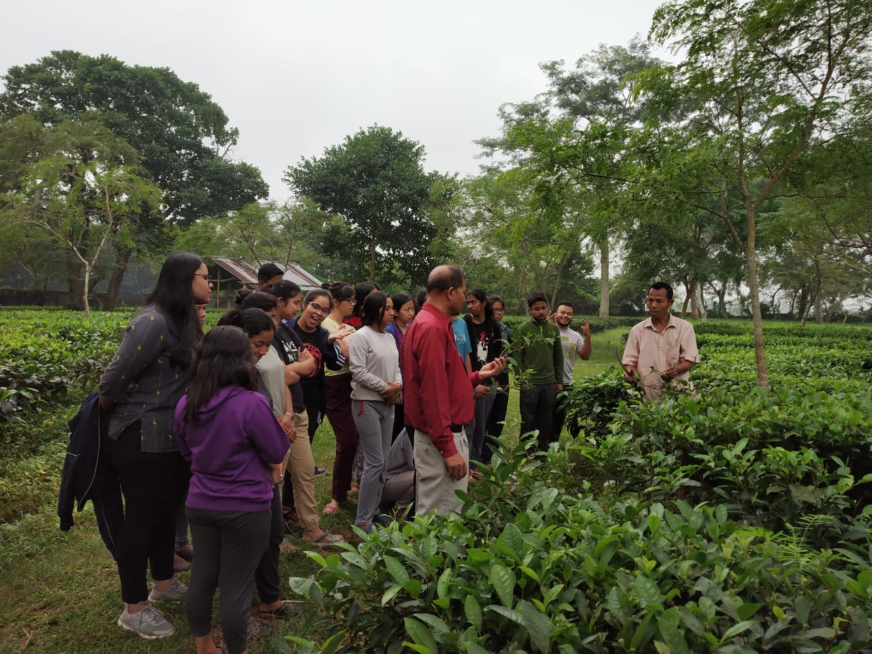
Agricultural Higher Education in India
Dr. RC Agrawal, Deputy Director General (Ag. Education), ICAR
ddg.edu@icar.gov.in

Slide 2
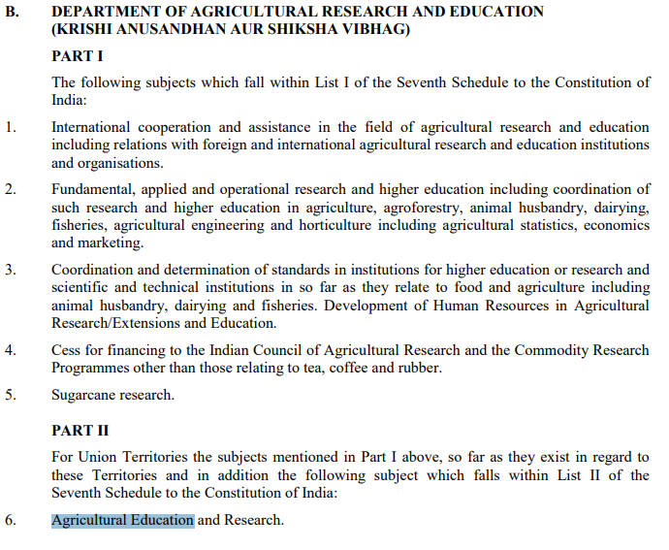
Allocation of Business by Govt. of India
Co-ordination and determination of standards in institutions for higher education or research and scientific and technical institutions in so far as it relates to food and agriculture including animal husbandry, dairying and fisheries.

Slide 3
Domains Of Agricultural Universities in India
95
Domain of AU | Number
SAUs | 39
Veterinary Universities | 15
Horticulture Universities | 06
Fisheries Universities | 03
Deemed Universities | 04
CAUs | 03
CUs with Agricultural Faculties | 04
80
11
PG Level Subjects
UG Level Subjects
Doctoral Programs

Slide 4
Students in AUs
Domain of AU
UG | 76%
PG | 16%
Ph.D. | 8%
Total students in AUs | 1,48,878
Total intake (every year) | 45,000

Slide 5
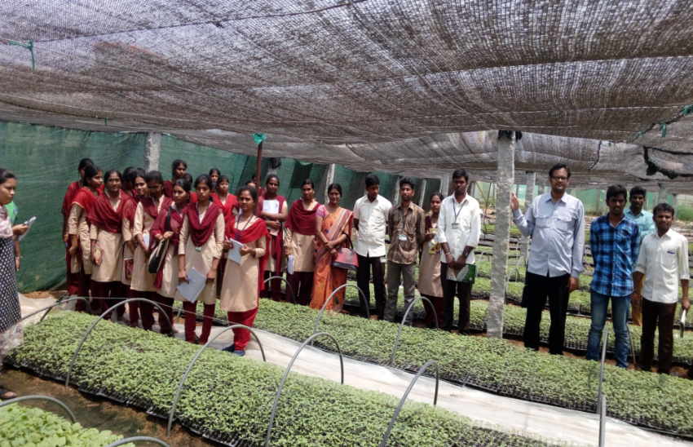
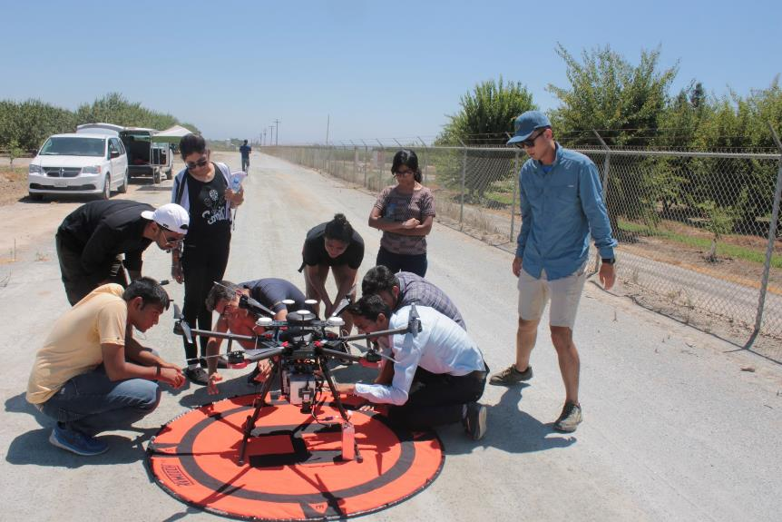
NEP provisions already followed in Agricultural Education
Four year UG programme across the country with uniform syllabus
Choice based credit system giving adequate flexibility to suit the local agro-climatic requirements
Mandatory Student READY to inculcate experiential learning & entrepreneurship
Focus on setting Start-up/incubation centres/greater linkages industry–academic
Vibrant campus life for high quality teaching-learning process
The M.Phil. programme was not included in agricultural education
Financial assistance to students (NTS-UG, NTS-PG, Student READY, PG Scholarships JRF/SRF)

Slide 6
Assessment of budget and faculty student ratio compare to others
Sources: https://www.usnews.com/education/best-global-universities/wageningen-university-and-research-center-501112
https://en.wikipedia.org/wiki/University_of_California ; and Annual Reports of IIMA and IITG (2020-21),
Legends: HU: Harvard University, UOC: University of California, OU: University of Ottawa, WUR: Wageningen University & Research, IITG:, Indian Institute Technology of Guwahati., IIMA: Indian Institute of Management, Ahmadabad, ICAR/AUs: Indian Council of Agricultural Research/ Agricultural University

Slide 7
Overall categorization of AUs based on budget size
2019-20
2020-21
2021-22
Average: INR 216 Crores
Average: INR 200 Crores
Average: INR 235 Crores
The average budget size has reduced in 2020-21 in comparison to 2019-20 and only one university had more than 600 crore budget compared to 4 universities in 2019-20. In 2021-22, 5 universities are having more than 600 crore budget.
Values in INR Crores, Data – FY 19-20, Total number of AUs: 66 (SAUs 60, CAUs & Deemed: 6)
FY 20-21, Total number of AUs: 67 (SAUs 61, CAUs & Deemed: 6)
FY 21-22, Total number of AUs: 67 (SAUs 61, CAUs & Deemed: 6)

Slide 8
Requirement of students in ICAR- AU system as per ideal Faculty Student ratio
How to meet ideal Faculty student ratio (1:10)? Assumption- Number of in-position faculties have been kept constant
Parameters | SAU |  |  | CAU |  |  | ICAR |  |  | Overall
 | 2019 | 2020 | 2021 | 2019 | 2020 | 2021 | 2019 | 2020 | 2021 | 2019 | 2020 | 2021
Existing students’ strength in AU (Average per AU) | 2,028 | 2,186 | 2,315 | 1,543 | 1,745 | 2,133 | 747 | 1,489 | 842 | 1,935 | 2,131 | 2,222
Existing Faculty student ratio | 1:7 | 1:8 | 1:8 | 1:4 | 1:6 | 1:6 | 1:4 | 1:5 | 1:4 | 1:7 | 1:7 | 1:8
Additional students which can be accommodated to meet the ideal FS ratio (average per AU) | 1,067 | 898 | 814 | 1,823 | 1,231 | 1,402 | 1,633 | 1,689 | 1,498 | 1,124 | 955 | 872
Total number of students (approx.) which can be accommodated in ICAR- AU system with ideal FS ratio (leading to effective utilization of in- position faculties) |  |  |  |  |  |  |  |  |  | 74,208 | 63,992 | 58,452
As per AICTE and NIRF’s ideal FS recommendations, an additional ~74.2K students could have been accommodate as per 2019-20 data. It is evident from the table that ICAR AU system has managed to fill about 14% of these seats in 2020-21 and further 9% in 2021-22. The overall projections may vary based on time contribution of faculties on teaching, research and extension, intake capacities of AUs, other ICAR & state level policy related decisions etc.

Slide 9
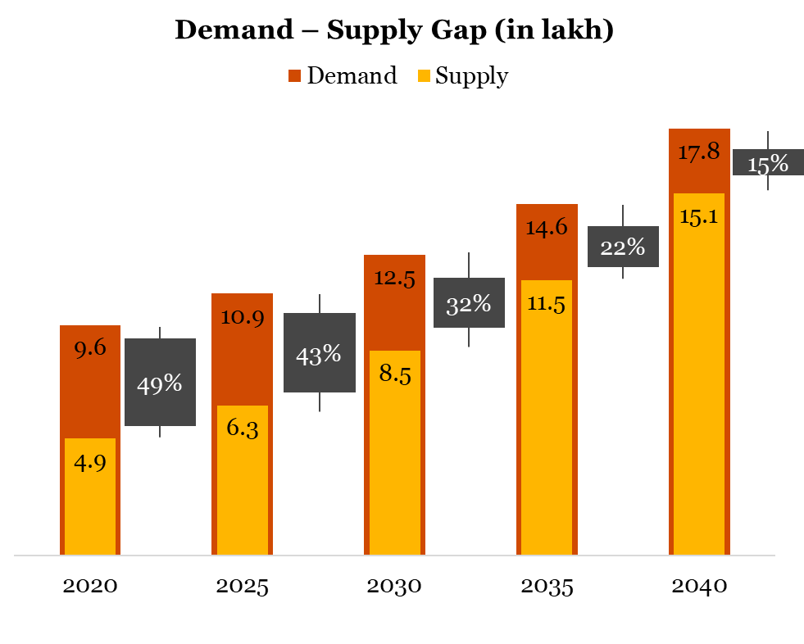
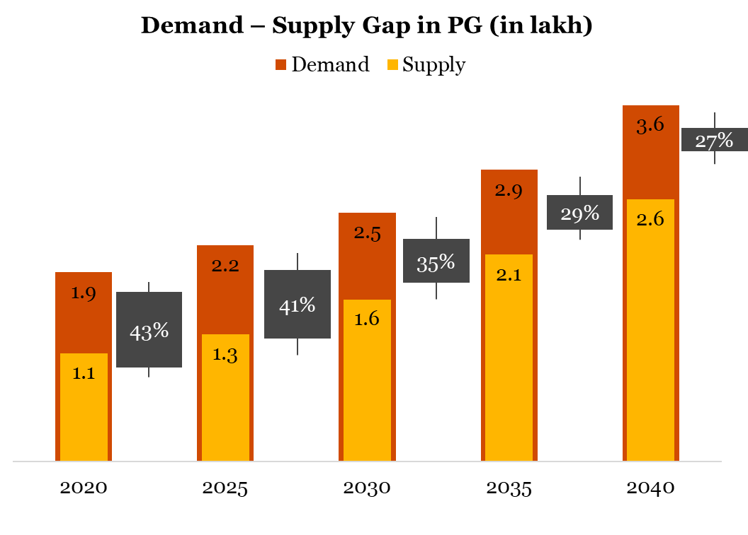
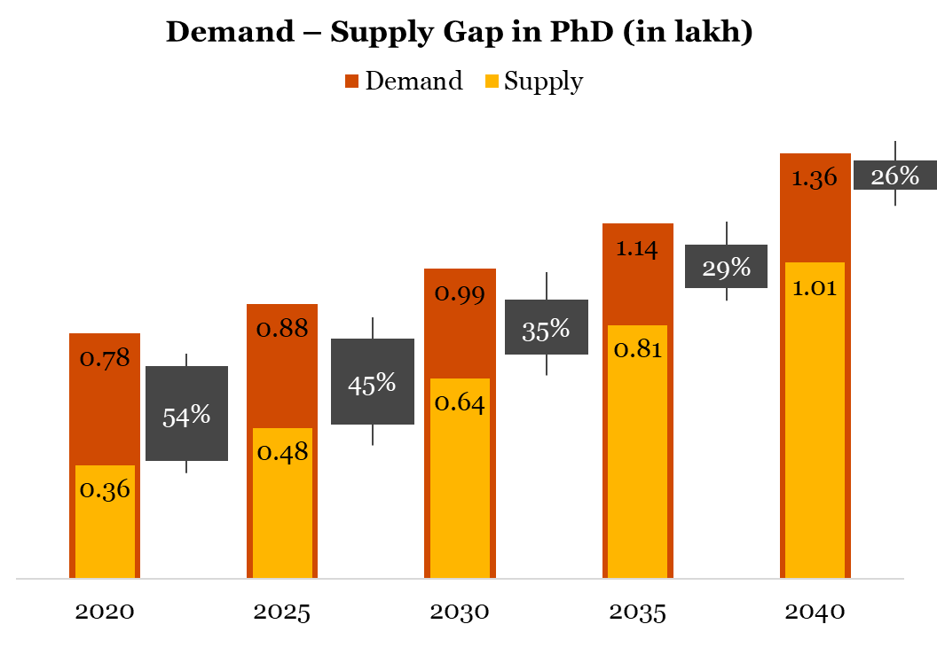
Overall Supply and Demand Gap estimations
Looking at the supply demand gap for current year, the total demand for agriculture and allied graduates is 9,58,777 whereas the total available supply stock during the year is 4,88,882. It may be observed that there is a 49% gap in demand and supply of overall agriculture and allied graduates.
The gap for 2025 stands at 43%, for 2030 it is 32% and for 2035 it is 22% whereas in 2040 it will significantly drop to 15%.
Demand is expected to grow at 3.1% CAGR from 9.5 lakhs to 17.7 lakhs from 2020-40
~80% of total demand is for the top 5 streams (Agri, Veterinary, Horti, Agri. Engineering & ABM)
Agri Engineering & ABM is expected to grow at higher rate of 3.9% whereas forestry has lowest growth rate of 2.4%
At the education level wise, UG has the maximum share in total demand of about 72% followed by PG & PhD.

Slide 10
Strategic recommendations from study – Short Term (1/2)
Recommendation
Additional colleges required
Requirement of additional colleges imparting agri higher education
Streams | Total colleges required in 2040 | Total colleges available in 2020 | New colleges required
Agriculture | 559 | 434 | 125
Veterinary Science | 220 | 155 | 65
Horticulture | 284 | 153 | 131
Agri. Engineering | 111 | 100 | 11
Agri. Biotechnology | 80 | 56 | 24
Food Science & Technology | 97 | 65 | 32
Forestry | 54 | 54 | -
Fisheries | 95 | 64 | 31
Dairy Science | 123 | 47 | 76
Community Science | 60 | 60 | -
Agri-business Management | 112 | 60 | 52
Sericulture | 10 | 8 | 2
Food Nutrition & Dietetics | 5 | 3 | 2
 | 1,811 | 1,259 | 552
Approach
Requirement of additional 552 colleges across disciplines
ICAR may deliberate in consultation with the state government and plan to increase these additional number of colleges by 2040 in phases
There won’t be any requirement of new colleges for PG & PhD separately

Slide 11
NEP provisions already followed in Agricultural Education
Four year UG programme across the country with uniform syllabus
Choice based credit system giving adequate flexibility to suit the local agro-climatic requirements
Mandatory Student READY to inculcate experiential learning & entrepreneurship
Focus on setting Start-up/incubation centres/greater linkages industry–academic
Vibrant campus life for high quality teaching-learning process
The M.Phil. programme was not included in agricultural education
Financial assistance to students (NTS-UG, NTS-PG, Student READY, PG Scholarships JRF/SRF)

Slide 12
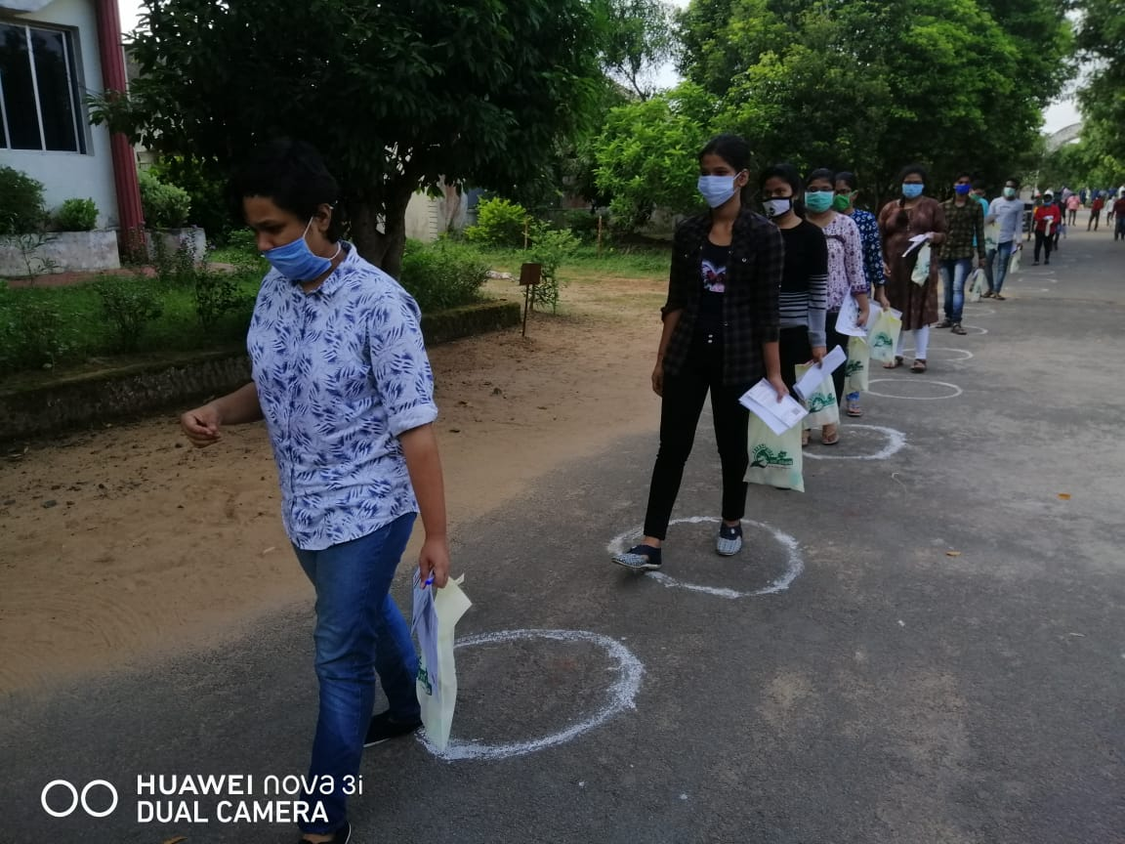
Major recommendations of Roadmap developed by ICAR
The relaxation in residential requirements of UG, and PG (Done)
Compliance with Academic Bank of Credits (ABC) as per the directives of the Ministry of Education (Done)
Common entrance test may be conducted by ICAR for admission of the students in all the AUs (20 AUs using ICAR entrance exam score)
AUs to increase at least 10% seats starting from 2021-22 academic session on annual basis (Already implemented. There is increase of 20% students during last 2 YEARS)
Multiple exit and entry to be implemented as per guidelines (Constituted Deans committee)

Slide 13
Course Curriculum Developed during last 4 years
Type of the course
58 Course curriculums developed
Communication skills
Communication Skills
Industry Oriented Courses
Entrepreneurial Skills
Other Courses:
Skill development
Vocational Course
Specialized taught course
Scientific English
Communication and Soft kills
Sci-Com for Smart Scholars
Beneficiaries by course type
Industry Oriented Courses
Biologicals
Pet Industry
Equine Industry
Bio Science Research
Poultry Farming
Production of Bio pesticides
Entrepreneurship skills
Other Courses
Dairy Farming
Certificate Course on Export-Import of Agricultural Commodities
Hygienic handling and value-added products of fish and shellfish
Remedial Courses on:
Veterinary Anatomy
Engineering Mathematics
Creative and Innovative Thinking

Slide 14
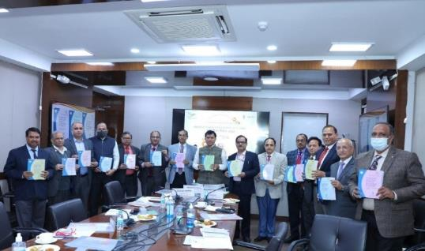
BSMA RECOMMENDATIONS RELEASED ON
AGRICULTURAL EDUCATION DAY

Slide 15
Indian research publications growth and Impact of CeRA (As per SCIMAGO Journal Rank based on Scopus Data)
Global Rank 4
India surpassed
UK, Germany, Japan, Canada, France, Australia and Spain
and become the Fourth largest producer of research papers in Agriculture and Biological Sciences in 2021
291.83%
Global Rank 11

Slide 16
Growth of Indian research publications (Asiatic Region) 2007 - 2021 (As per SCIMAGO Journal Rank based on Scopus Data)
552.94%

Slide 17
KRISHI KOSH: A DIGITAL REPOSITORY FOR NARES
Unique repository of knowledge in agriculture and allied sciences, having collection of
Thesis
(1.80 lakh thesis)
Technical bulletins
Old and valuable books
Project Reports
Lectures, preprints, reprints, records and various documents spread all over the country in different libraries of Research Institutions and State Agricultural Universities (SAUs)
Institutional Publications

Slide 18
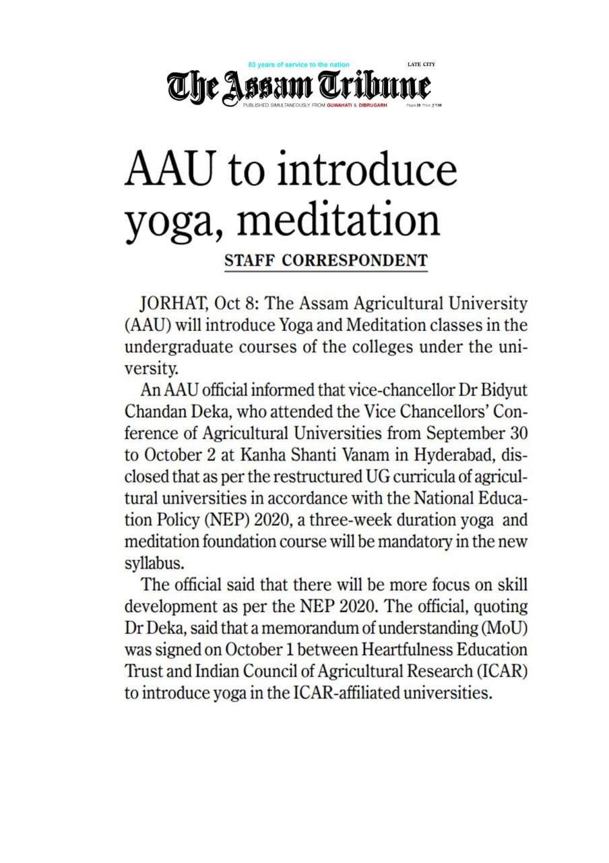
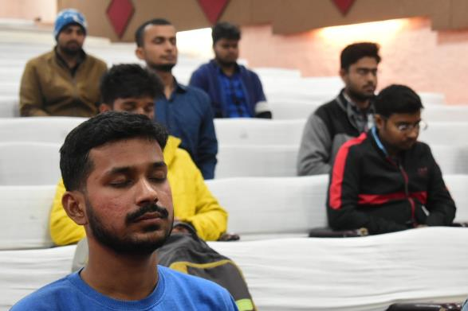

Slide 19
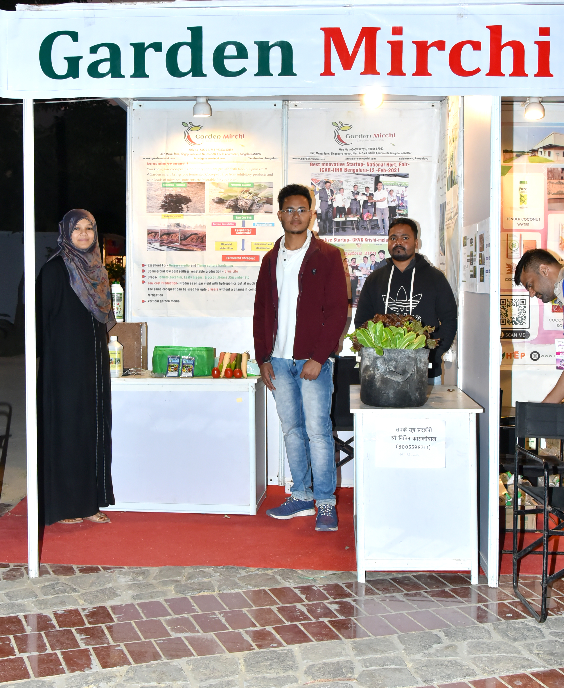
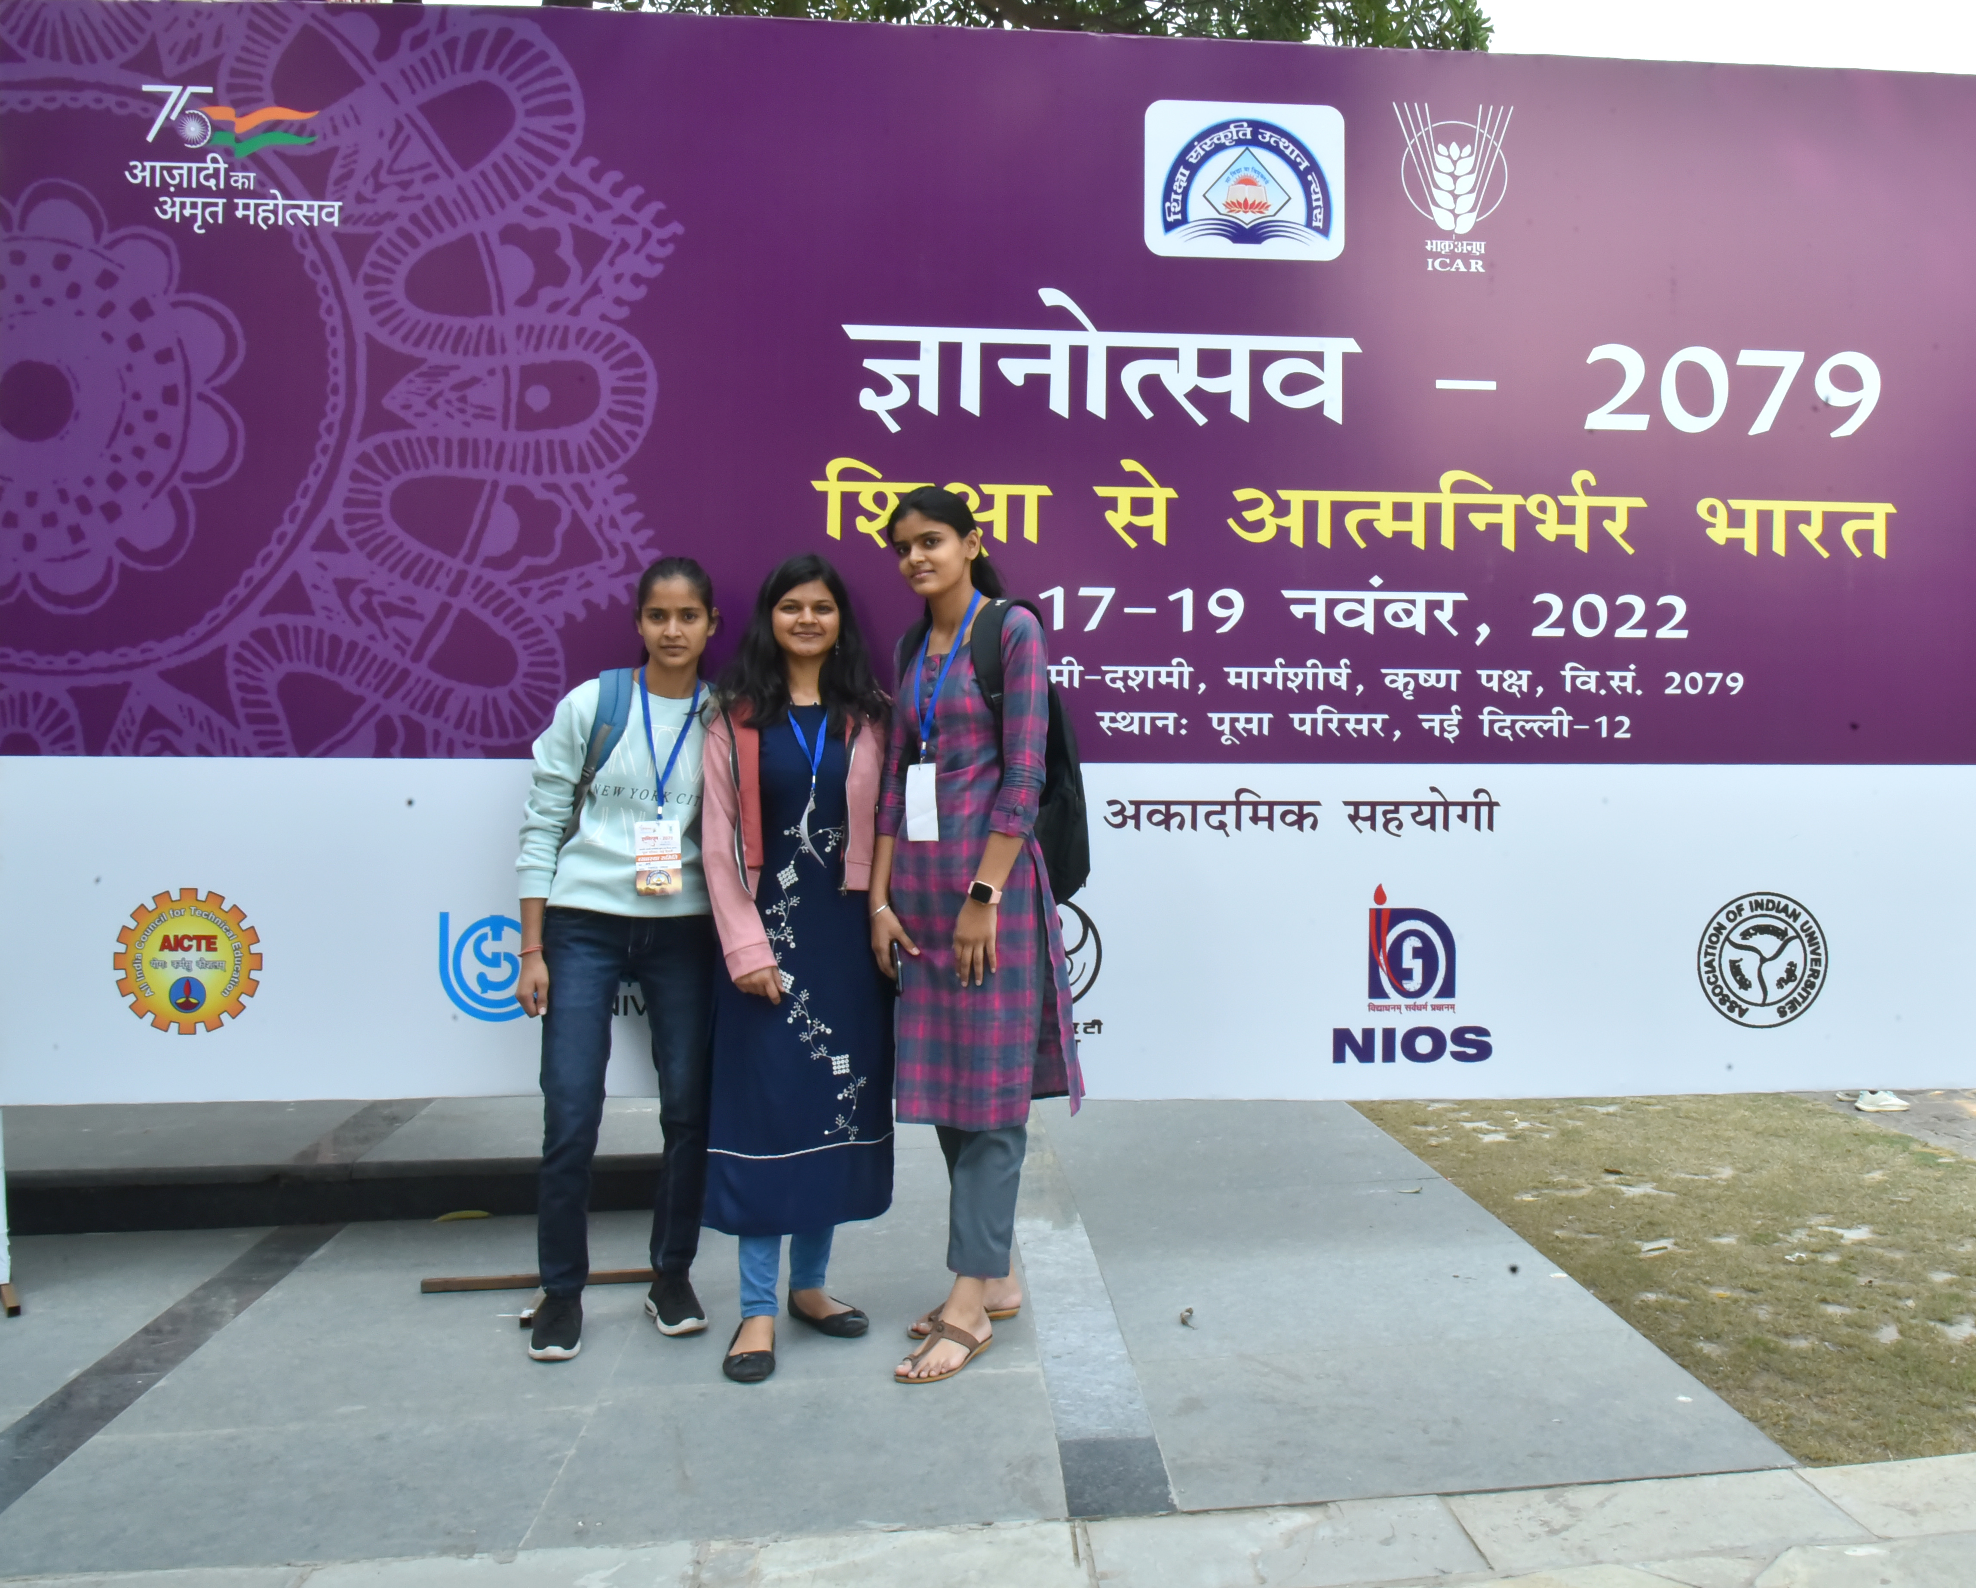

Slide 20
Approach to Global Rankings
1
6
Marketing & communications framework
Website, social media handle
FUNDING
ASSURANCE
Sources of funding
Funding strategy
MARKETING & COMMUNICATION
2
5
Orient researchers & publish papers in SCOPUS
Identify and bridge gaps
IMPROVING RESEARCH OUTPUT
PROPOSED
APPROACH
INTERNATIONALISATION
Induct international students/ faculty
Mitigate barriers to entry
3
4
INDUSTRY- ACADEMIA LINKAGES
DATA-DRIVEN PRACTICES
Data on student experience, engagement and skills Provide rapid feedback to improve operations
Partnerships with industry players
Develop industry academia cell

Slide 22
Agricultural Higher Education
Weak demand but key input for growth
Study options for agriculture & allied subjects for schools
Agricultural education can be introduced through experiential learning – e.g. Farm visits, School kitchen gardens
Primary Level
Grades 1 – 5
Secondary Level
Grades 6 - 8
Specialized modules related to agriculture & allied sectors can be introduced in subjects like agri economics, plant science etc.
Short vocational, skills based study courses focussed on segments of the Agri value chain, to be taught under the STEAM subjects umbrella
Higher Sr. Level
Grades 11 & 12

Slide 23
VIRTUAL CLASSROOM &
AGRI-DIKSHA WEB CHANNEL
“A virtual classroom, is a system that provides the same opportunities for the teaching and learning process, beyond the physical limits of the traditional classroom's walls”
Virtual Classrooms were established in all AUs under NAHEP - Component 2
In 2021-2022, 20+ capacity building sessions were conducted for more than 2200 participants from Agricultural Universities

Slide 24
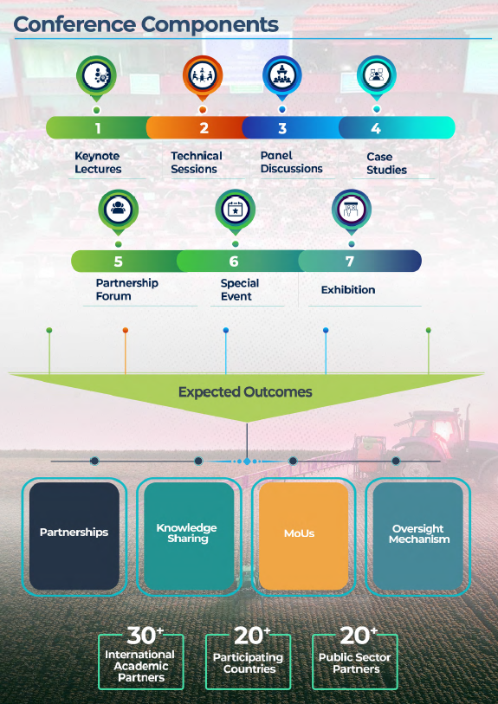

Slide 25
Initiated a new Agricultural Magazine (quarterly)

Slide 26
Appeal to Agri-Universities
Plan for the NEP-2020 implementation as per ICAR Roadmap
Implementation of new Academic Regulations as per BSMA of ICAR
Plan for more Revenue Generation in AUs (Total Revenue of all AUs has increased by Rs. 200 Crores during last 1 year. Total revenue Rs. 2000 Crore )
Plan for Incubation Centres for better entrepreneurship
Utilization of digital platforms of ICAR including Academic Management System and Education Portal in real time basis
Start utilizing Virtual Classrooms provided by ICAR and Agri-DIKSHA
Register for Academic Bank of Credit (ABC) as per NEP
ICAR going to join Common University Entrance Test (CUET) from next year
Explore PPP mode for infrastructure

Slide 27
Thanks

